Slide 1
FreeRTOS

Slide 2
Introduction to multitasking in Small Embedded Systems
Most embedded real-time applications include a mix of both hard and soft real-time requirements.
Soft real-time requirements
State a time deadline, but breaching the deadline would not render the system useless.
E.g., responding to keystrokes too slowly
Hard real-time requirements
State a time deadline, but breaching the deadline would result in absolute failure of the system.
E.g., a driver’s airbag would be useless if it responded to crash event too slowly.

Slide 3
FreeRTOS
FreeRTOS is a real-time kernel/scheduler on top of which MCU applications can be built to meet their hard real-time requirements.
Allows MCU applications be organized as a collection of independent threads of execution.
Decides which thread should be executed by examining the priority assigned to each thread.
Assume a single core MCU, where only a single thread can be executing at one time.

Slide 4
The simplest case of task priority assignments
Assign higher priorities (lower priorities) to threads that implement hard real-time (soft real-time) requirements
As a result, hard real-time threads are always executed ahead of soft real-time threads.
But, priority assignment decision are not always that simple.
In general, task prioritization can help ensure an application meet its processing deadline.

Slide 5
A note about terminology
In FreeRTOS, each thread of execution is called a ‘task’.

Slide 6
Why use a real-time kernel
For a simple system, many well-established techniques can provide an appropriate solution without the use of a kernel.
For a more complex embedded application, a kernel would be preferable.
But where the crossover point occurs will always be subjective.
Besides ensuring an application meets its processing deadline, a kernel can bring other less obvious benefits.

Slide 7
Benefits of using real-time kernel 1
Abstracting away timing information
Kernel is responsible for execution timing and provides a time-related API to the application. This allows the application code to be simpler and the overall code size be smaller.
Maintainability/Extensibility
Abstracting away timing details results in fewer interdependencies between modules and allows sw to evolve in a predictable way.
Application performance is less susceptible to changes in the underlying hardware.
Modularity
Tasks are independent modules, each of which has a well-defined purpose.
Team development
Tasks have well-defined interfaces, allowing easier development by teams

Slide 8
Benefits of using real-time kernel 2
Easier testing
Tasks are independent modules with clean interfaces, they can be tested in isolation.
Idle time utilization
The idle task is created automatically when the kernel is started. It executes whenever there are no application tasks to run.
Be used to measure spare processing capacity, perform background checks, or simply place the process into a low-power mode.
Flexible interrupt handling
Interrupt handlers can be kept very short by deferring most of the required processing to handler tasks.

Slide 9
Standard FreeRTOS features
Pre-emptive or co-operative operation
Very flexible task priority assignment
Queues
Binary/Counting / Recursive semaphores
Mutexes
Tick/Idle hook functions
Stack overflow checking
Trace hook macros
Interrupt nesting

Slide 10
Outline
Task Management
Queue Management
Interrupt Management
Resource Management
Memory Management
Trouble Shooting

Slide 11
Task management

Slide 12
1. Introduction and scope
Main topics to be covered
How FreeRTOS allocates processing time to each task within an application
How FreeRTOS chooses which task should execute at any given time
How the relative priority of each task affects system behavior
The states that a task can exist in.

Slide 13
More specific topics
How to implement tasks
How to create one or more instances of a task
How to use the task parameter
How to change the priority of a task that has already been created.
How to delete a task.
How to implement periodic processing.
When the idle task will execute and how it can be used.

Slide 14
1.2 Task functions
Tasks are implemented as C functions.
Special: Its prototype must return void and take a void pointer parameter as the following
void ATaskFunction (void *pvParameters);
Each task is a small program in its own right.
Has an entry point
Normally runs forever within an infinite loop
Does not exit

Slide 15
Special features of task function
FreeRTOS task
Must not contain a ‘return’ statement
Must not be allowed to execute past the end of the function
If a task is no longer required, it should be explicitly deleted.
Be used to create any number of tasks
Each created task is a separate execution instance with its own stack, and its own copy of any automatic variables defined within the task itself.

Slide 16
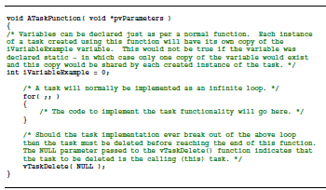

Slide 17
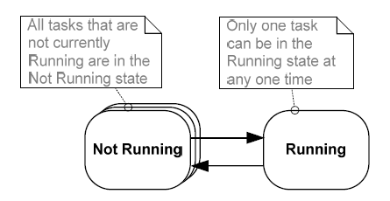
1.3 Top level task states
A task can exist in one of two states: Running and Not Running
Scheduler is the only entity that can switch a task in and out a running state.
Running state: the processor is
executing its code.
Not Running state: the task is dormant,
its status having been saved ready
for resuming execution the next time
Notes:
If MCU contains a single core, only one task can be executing at any given time, so

Slide 18
1.4 Creating Tasks
xTaskCreate() API function
the most fundamental component in a multitasking system
Probably the most complex of all API functions
portBASE_TYPE xTaskCreate(
pdTASK_CODE pvTaskCode,
const signed char * const pcName,
unsigned short usStackDepth,
void *pvParameters,
unsigned portBASE_TYPE uxPriority,
xTaskHandle *pxCreatedTask
);

Slide 19
All parameters
pvTaskCode
a pointer to the function (just the function name) that implements the task.
pcName
A descriptive name for the task. It is not used by FreeRTOS, but a debugging aid.
configMAX_TASK_NAME_LEN: the application defined constant that defines the maximum length a task name can task including the NULL terminator.

Slide 20
usStackDepth
Each task has its own unique stack that is allocated by the kernel to the task when the task is created.
The value specifies the number of words the task stack can hold.
E.g., Cortex-M3 stack is 32 bits wide, if usStackDepth is passed in as 100, 400 bytes of stack space will be allocated (100*4 bytes)
Size of the stack used by the idle task is defined by configMINIMAL_STACK_SIZE.
Adjustable w.r.t. applications
Notes:
No easy way to determine the stack space required by a task.
Must be adequate and that RAM is not being wasted unnecessarily

Slide 21
pvParameters
The value assigned to pvParameters will be the values passed into the task.
uxPriority
defines the priority at which the task will execute.
Priorities can be assigned from 0, which is the lowest priority, to (configMAX_PRIOIRTIES-1), which is the highest priority.
Passing a value above (configMAX_PRIOIRTIES -1) will result in the priority being capped the maximum legitimate value.
Notes:
Task functions accept a parameter of type pointer to void (void*).

Slide 22
pxCreatedTask
pass out a handle to the created task, then be used to refer the created task in API calls.
E.g., change the task priority or delete the task
Be set to NULL if no use for the task handle
Two possible return values
pdTRUE : task has been created successfully.
errCOULD_NOT_ALLOCATE_REQUIRED_MEMORY
Task has not been created as there is insufficient heap memory available for FreeRTOS to allocate enough RAM to hold the task data structures and stack.

Slide 23
Example 1 Creating tasks
To demonstrate the steps of creating two tasks then starting the tasks executing.
Tasks simply print out a string periodically, using a crude null loop to create the periodic delay.
Both tasks are created at the same priority and are identical except for the string they print out.

Slide 24
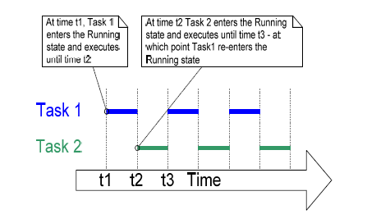
Execution pattern of two Example 1 tasks
Both tasks are rapidly entering and exiting the Running state.
Only one task can exist in the Running state at any one time.

Slide 25
Example 2 Using the task parameter
The two tasks in Example 1 are almost identical, the only difference between them being the text string they print out.
Remove such duplication by creating two instances of a single task implementation vTaskFunction.
Each created instance will execute independently under the control of the FreeRTOS scheduler.
The task parameter can then be used to pass into each task the string that it should print out.

Slide 26
First define a char string pcTextForTask1
static const char *pcTextForTask1 = “Task 1 is running.\n”;
Then, in main(void) function, change
xTaskCreate( vTask1, "Task 1", 240, NULL, 1, NULL );
to
xTaskCreate( vTaskFunction, "Task 1", 240, (void*)pcTextForTask1, 1, NULL );
Create a task function vTaskFunction(void * pvParameters)
char *pcTaskName;
pcTaskName = (char *) pvParameters;

Slide 27
1.5 Task priorities
uxPriority parameter of xTaskCreate() assigns an initial priority to the task being created.
It can be changed after the scheduler has been started by using vTaskPrioritySet() API function
configMAX_RPIORITIES in FreeRTOSConfig.h
Maximum number of priorities
Higher this value, more RAM consumed
Range: [0(low), configMAX-PRIORITIES-1(high)]
Any number of tasks can share the same priority

Slide 28
To select the next task to run, the scheduler itself must execute at the end of each time slice.
Use a periodic interrupt called the tick (interrupt).
Effectively set the length of time slice by the tick interrupt frequency -- configTICK_RATE_HZ in FreeRTOSConfig.h
configTICK_RATE_HZ
If it is 100(Hz), the time slice will be 10 ms.
API always calls specify time in tick interrupts (ticks)
portTICK_RATE_MS
Convert time delays from milliseconds into the number of tick interrupts.
Notes:
Tick count is the total number of tick interrupts that have occurred since the scheduler was started

Slide 29
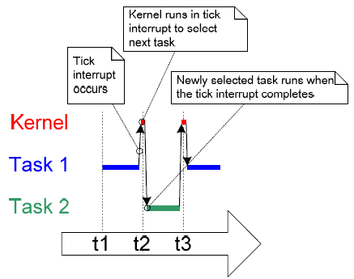
When kernel itself is running, the arrows in the above figure show the sequence of execution from task interrupt, then from interrupt back to a next task.

Slide 30
Example 3. Experimenting with priorities
Scheduler always ensures that the highest priority task is able to run is the task selected to enter the Running state.
In Example 1 and 2, two tasks have been created at the same priority, so both entered and exited the Running state in turn.
In this example, the second task is set at priority 2.

Slide 31
In main() function, change
xTaskCreate( vTaskFunction, "Task 2", 240, (void*)pcTextForTask2, 1, NULL );
To
xTaskCreate( vTaskFunction, "Task 2", 240, (void*)pcTextForTask2, 2, NULL );

Slide 32
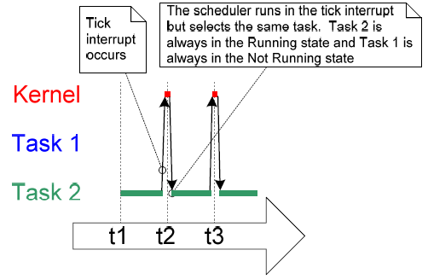
The scheduler always selects the highest priority task that is able to run.
Task 2 has a higher priority than Task 1; so Task 2 is the only task to ever enter the Running state.
Task 1 is to be ‘starved’ of processing time of Task 2.

Slide 33
‘Continuous processing’ task
So far, the created tasks always have work to perform and have never had to wait for anything
Always able to enter the Running state.
This type of task has limited usefulness as they can only be created at the very lowest priority.
If they run at any other priority, they will tasks of lower priority ever running at all.
Solution: Event-driven tasks

Slide 34
1.6 Expanding the ‘Not Running’ state
An event-driven task
has work to perform only after the occurrence of the event that triggers it
Is not able enter the Running state before that event has occurred.
The scheduler selects the highest priority task that is able to run.
High priority tasks not being able to run means that the scheduler cannot select them, and
Must select a lower priority task that is able to run.
Using event-driven tasks means that
tasks can be created at different priorities without the highest priority tasks starving all the lower priority tasks.

Slide 35
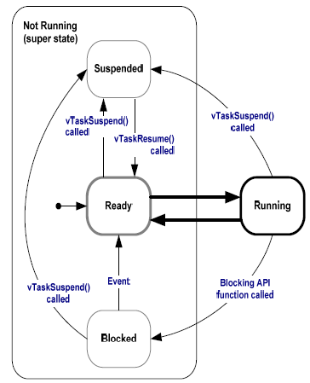
Full task state machine

Slide 36
Blocked state
Tasks enter this state to wait for two types of events
Temporal (time-related) events: the event being either a delay expiring, or an absolute time being reached.
A task enter the Blocked state to wait for 10ms to pass
Synchronization events: where the events originate from another task or interrupt
A task enter the Blocked state to wait for data to arrive on a queue.
Can block on a synchronization event with a timeout, effectively block on both types of event simultaneously.
A task waits for a maximum of 10ms for data to arrive on a queue. It leaves the Blocked state if either data arrives within 10ms or 10ms pass with no data arriving.

Slide 37
Suspended state
Tasks in this state are not available to the scheduler.
The only way into this state is through a call to the vTaskSuspend() API function
The only way out this state is through a call to the vTaskResume() or vTaskResumeFromISR() API functions

Slide 38
Ready state
Tasks that are in the ‘Not Running’ state but are not Blocked or Suspended are said to be in the Ready state.
They are able to run, and therefore ‘ready’ to run, but are not currently in the Running state.

Slide 39
Example 4 Using the Block state to create a delay
All tasks in the previous examples have been periodic
They have delayed for a period and printed out their string before delay once more, and so on.
Delayed generated using a null loop
the task effectively polled an incrementing loop counter until it reached a fixed value.

Slide 40
Disadvantages to any form of polling
While executing the null loop, the task remains in the Ready state, ‘starving’ the other task of any processing time.
During polling, the task does not really have any work to do, but it still uses maximum processing time and so wastes processor cycles.
This example corrects this behavior by
replacing the polling null loop with a call to vTaskDelay() API function.
setting INCLUDE_vTaskDelay to 1 in FreeRTOSConfig.h

Slide 41
vTaskDelay() API function
Place the calling task into the Blocked state for a fixed number of tick interrupts.
The Blocked state task does not use any processing time, so processing time is consumed only when there is work to be done.
void vTaskDelay(portTickType xTicksToDelay);
xTicksToDelay: the number of ticks that the calling task should remain in the Blocked state before being transitioned back into the Ready state.
E.g, if a task called vTaskDelay(100) while the tick count was 10,000, it enters the Blocked state immediately and remains there until the tick count is 10,100.

Slide 42
In void vTaskFunction(void *pvParameters)
Change a NULL loop
for( ul = 0; ul < mainDELAY_LOOP_COUNT; ul++ ) { }
To
vTaskDelay(250 / portTICK_RATE_MS);
// a period of 250ms is being specified.
Although two tasks are being created at different priorities, both will now run.

Slide 43
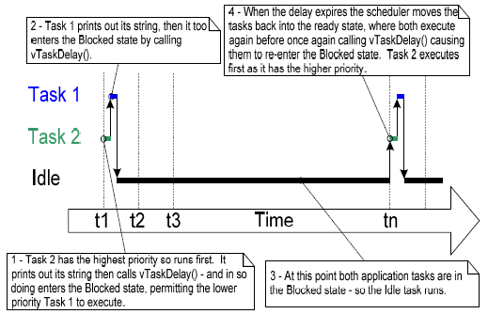
Each time the tasks leave the Blocked state they execute for a fraction of a tick period before re-entering the Blocked state.
Most of the time no application tasks are able to run and, so, no tasks can be selected to enter the Running state.
The idle task will run to ensure there is always at least one task that is able to run.
Notes:
The idle task is created automatically when the scheduler is started, to ensure there is always at least one task that is able to run.

Slide 44
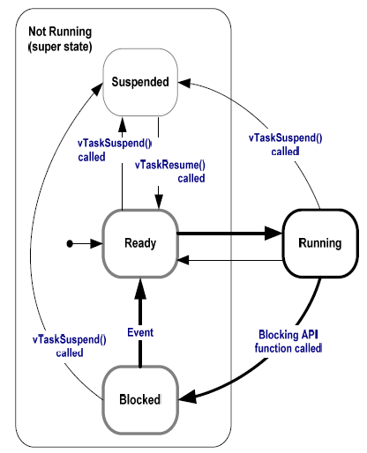
Bold lines indicate the state transitions performed by the tasks in Example 4

Slide 45
vTaskDelayUntil() API Function
Parameters to vTaskDelayUntil()
specify the exact tick count value at which the calling task should be moved from the Blocked state into the Ready state.
Be used when a fixed execution period is required.
The time at which the calling task is unblocked is absolute, rather than relative to when the function was called (as vTaskDelay())
void vTaskDelayUntil(
portTickType *pxPreviousWakeTime,
portTickType xTimeIncrement);

Slide 46
vTaskDelayUntil() prototype
pxPreviousWakeTime
Assume that vTaskDelayUtil() is being used to implement a task that executes periodically and with a fixed frequency.
Holds the time at which the task left the Blocked state.
Be used as a reference point to compute the time at which the task next leaves the Blocked state.
The variable pointed by pxPreviousWakeTime is updated automatically, not be modified by application code, other than when the variable is first initialized.

Slide 47
xTimeIncrement
Assume that vTaskDelayUtil() is being used to implement a task that executes periodically and with a fixed frequency – set by xTimeIncrement.
Be specified in ‘ticks’. The constant portTICK_RATE_MS can be used to convert ms to ticks.

Slide 48
Example 5 Converting the example tasks to use vTaskDelayUntil()
Two tasks created in Example 4 are periodic tasks.
vTaskDelay() does not ensure that the frequency at which they run is fixed,
as the time at which the tasks leave the Blocked state is relative to when they call vTaskDelay().

Slide 49
In void vTaskFunction(void *pvParameters)
Change
vTaskDelay(250 / portTICK_RATE_MS);
// a period of 250ms is being specified.
To
vTaskDelayUntil( &xLastWakeTime, (vTaskDelay(250 / portTICK_RATE_MS));
/*xLastWakeTime is initialized with the current tick count before entering the infinite loop. This is the only time it is written to explicitly. */
xLastWakeTime = xTaskGetTickCount();
/*It is then updated within vTaskDelayUntil(); automatically */

Slide 50
Example 6 Combining blocking and non-blocking tasks
Two tasks are created at priority 1.
Always be either the Ready or the Running state as never making any API function calls.
Tasks of this nature are called continuous processing tasks they always have work to do.
A Third task is created at priority 2.
Periodically prints out a string by using vTaskDelayUntil() to place itself into the Blocked state between each print iteration.

Slide 51
void vContinuousProcessingTask(void * pvParameters) {
char *pcTaskName;
pcTaskName = (char *) pvParameters;
for (;;){ vPrintString(pcTaskName);
for( ul = 0; ul < 0xfff; ul++ ) { }
}}
void vPeriodicTask(void * pvParameters) {
portTickType xLastWakeTime;
xLastWakeTime = xTaskGetTickCount();
for (;;){ vPrintString(“Periodic task is running\n”);
vTaskDelayUntil(&xLastWakeTime,
(10/portTICK_RATE_MS));
}}

Slide 52
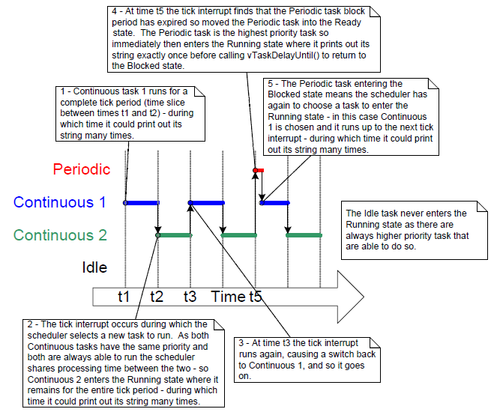

Slide 53
1.7 Idle Task and the Idle task hook
An idle task is automatically created by the scheduler when vTaskStartScheduler() is called.
Does very little more than site in a loop
Has the lowest possible priority (zero), to ensure it never prevents a higher priority application task from entering the Running state
Be transitioned out of the Running state as soon as a higher priority task enters the Ready state

Slide 54
The Idle task is immediately swapped out to allow Task 2 to execute at the instant Task 2 leaves the Blocked state.
Task 2 pre-empts the idle task automatically.

Slide 55
Idle Task Hook Functions
Add application specific functionality directly into the idle task by the use of an idle hook
A function called automatically by the idle task once per iteration of the idle task loop
Common uses for the Idle task hook
Executing low priority, background, or continuous processing
Measuring the amount of spare processing capacity
Placing the processor into a low power mode, providing an automatic method of saving power whenever no application processing to be performed.

Slide 56
Limitations on the implementation of Idle Task Hook Functions
Rules idle task hook functions must adhere to
Must never attempt to block or suspend.
If the application uses vTaskDelete(), the Idle task hook must always return to its caller within a reasonable time period.
Idle task is responsible for cleaning up kernel resources after a task has been deleted.
If the idle task remains permanently in the Idle hook function, this clean-up cannot occur.
Idle task hook functions have the name and prototype as
void vApplicationIdleHook(void);

Slide 57
Example 7 Defining an idle task hook function
Set configUSE_IDLE_HOOK to 1
Add following function
unsigned long ulIdleCycleCount = 0UL;
/* must be called this name, take no parameters and return void. */
void vApplicationIdleHook (void) {
ulIdleCycleCount++;
}
In vTaskFunction(), change
vPrintString(pcTaskName) To
vPrintStringAndNumber(pcTaskName, ulIdleCycleCount);

Slide 58
1.7 Idle task and Idle Task Hook
Has the lowest priority, possible to add functionality into the idle task vi idle hook
Execute continuous processing
Measuring spare processing capacity
Placing the processor into a low power mode
Two rules
Never block or suspend; must return to its caller within a reasonable time period, as it needs to clean up kernel resources after a deleted task.

Slide 59
1.8 Change the priority of a task
vTaskPrioritySet(xTaskHandle pxTask, unsigned portBASE_TYPE uxNewPriority);
Be used to change the priority of any task after the scheduler has been started.
Available if INCLUDE_vTaskPrioritySet is set 1.
Two parameters
pxTask: Handle of the task whose priority is being modified. A task can change its own priority by passing NULL in place of a valid task handle.
uxNewPriority: the priority to be set.

Slide 60
unsigned portBASE_TYPE uxTaskPriorityGet(xTaskHandle pxTask);
Be used to query the priority of a task
Available if INCLUDE_vTaskPriorityGet is set 1
pxTask: Handle of the task whose priority is being modified. A task can query its own priority by passing NULL in place of a valid task handle.
Returned value: the priority currently assigned to the task being queried

Slide 61
Example 8 Changing task priorities
Demonstrate the scheduler always selects the highest Ready state task to run
by using the vTaskPrioritySet() API function to change the priority of two tasks relative to each other.
Two tasks are created at two different priorities.
Neither task makes any API function calls that cause it to enter the Blocked state,
So both are in either Ready or Running state.
So the task with highest priority will always be the task selected by the scheduler to be in Running state

Slide 62
Expected Behavior of Example 8
Task 1 is created with the highest priority to be guaranteed to run first. Task 1 prints out a couple of strings before raising the priority of Task 2 to above its own priority.
Task2 starts to run as it has the highest relative priority.
Task 2 prints out a message before setting its own priority back to below that of Task 1.
Task 1 is once again the highest priority task, so it starts to run and forcing Task 2 back into the Ready state.

Slide 63
Declare a global variable to hold the handle of Task 2.
xTaskHandle xTask2Handle;
In main() function, create two tasks
xTaskCreate(vTask1, “Task 1”, 240,
NULL, 2, NULL);
xTaskCreate(vTask2, “Task 2”, 240,
NULL, 1, &xTask2Handle);

Slide 64
Change vTask1 by initialization
unsigned portBASE_TYPE uxPriority;
uxPriority = uxTaskPriorityGet(NULL);
And adding to the infinite loop
vTaskPrioritySet(xTaskHandl1, (uxPriority+1));
Change vTask2 by initialization
unsigned portBASE_TYPE uxPriority;
uxPriority = uxTaskPriorityGet(NULL);
And adding to the infinite loop
vTaskPrioritySet(NULL, (uxPriority-2));

Slide 65
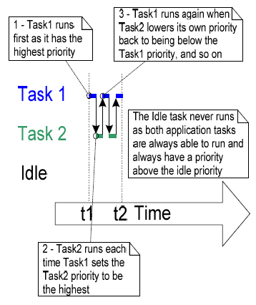
Task execution sequence

Slide 66
1.9 Deleting a task
Deleted tasks no longer exist and cannot enter the Running state again.
Idle task is responsible to automatically free memory allocated by kernel to tasks that have been deleted.
Remember if applications use vTaskDelete(), do not completely starve the idle task of all processing time.
Note: any memory or other resource that the application task allocates itself must by be freed explicitly by the application code.

Slide 67
vTaskDelete() API function
Function prototype
void vTaskDelete(xTaskHandle pxTaskToDelete);
pxTaskToDelete: Handle of the task that is to be deleted. A task can delete itself by passing NULL in place of valid task handle.
Available only when INCLUDE_vTaskDelete set 1

Slide 68
Example 9 Deleting tasks (Behavior)
Task 1 is created by main() with priority 1. When it runs, it creates Task 2 at priority 2. Task 2 as the highest priority task starts to execute immediately.
Task 2 does nothing but delete itself by passing NULL or its own task handle.
When Task 2 has been deleted, Task 1 is again the highest priority task, so continues executing – at which point it calls vTaskDelay() to block for a short period.
The idle task executes while Task 1 is in the blocked state and frees the memory that was allocated to the now deleted Task 2.
When Task 1 leaves the blocked state it again becomes the highest priority Ready state task and preempts the Idle task. Then, start from Step1 again.

Slide 69
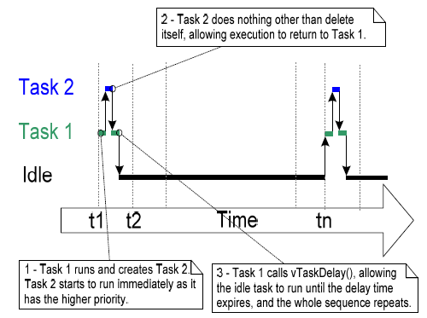
Execution sequence

Slide 70
Memory Management
Does not permit memory to be freed once it has been allocated.
Subdivide a single array into smaller blocks. Total size of the array (heap) is set by configTOTAL_HEAP_SIZE
xPortGetFreeHeapSize() returns the total amount of heap space that remains unallocated.

Slide 71
Heap_2.c
Allow previously allocated blocks to be freed.
Does not combine adjacent free blocks into a single large block.

Slide 73
Summary – 1. Prioritized pre-emptive scheduling
Examples illustrate how and when FreeRTOS selects which task should be in the Running state.
Each task is assigned a priority.
Each task can exist in one of several states.
Only one task can exist in the Running state at any one time.
The scheduler always selects the highest priority Ready state task to enter the Running state.

Slide 74
Fixed priority Pre-emptive scheduling
Fixed priority
Each task is assigned a priority that is not altered by the kernel itself (only tasks can change priorities)
Pre-emptive
A task entering the Ready state or having its priority altered will always pre-empt the Running state task, if the Running state task has a lower priority.

Slide 75
Tasks in the Blocked state
Tasks can wait in the Blocked state for an event and are automatically moved back to the Ready state when the event occurs.
Temporal events
Occur at a particular time, e.g. a block time expires.
Generally be used to implement periodic or timeout behavior.
Synchronization events
Occur when a task or ISR sends info to a queue or to one of the many types of semaphore.
Generally be used to signal asynchronous activity, such as data arriving at a peripheral.

Slide 76
Execution pattern with pre-emption points highlighted
Event for Task 1 occur at : t11
Task2 is released at : t1, t6, t9
Event for Task 3 occur at: t3, t5, t9, t12

Slide 77
Idle task
The idle task is running at the lowest priority, so get pre-empted every time a higher priority task enters the Ready state
E.g., at times t3,t5,t9.

Slide 78
Task 3
An event-driven task
Execute with a low priority, but above the Idle task priority.
It spends most of its time in the Blocked state waiting for the event of interest, transitioning from Blocked to Ready state each time the event occurs.
All FreeRTOS inter-task communication mechanisms (queues, semaphores, etc.) can be used to signal events and unblock tasks in this way.
Event occur at t3, t5, and also between t9 and t12.
The events occurring at t3 and t5 are processed immediately as it is the highest priority task that is able to run.
The event occurring somewhere between t9 and t12 is not processed as until t12 as until then Task 1 and 2 are still running. They enter Blocked state at t12, making Task 3 the highest priority Ready state task.

Slide 79
Task 2
A periodic task that executes at a priority above Task 3, but below Task1. The period interval means Task 2 wants to execute at t1, t6 and t9.
At t6, Task 3 is in Running state, but task 2 has the higher relative priority so preempts Task 3 and start to run immediately.
At t7, Task 2 completes its processing and reenters the Blocked state, at which point Task 3 can re-enter the Running state to complete its processing.
At t8, Task 3 blocks itself.

Slide 80
Task 1
Also an event-driven task.
Execute with the highest priority of all, so can preempt any other task in the system.
The only Task 1 event shown occurs at t10, at which time Task 1 pre-empts Task 2.
Only after Task 1 has re-entered the Blocked at t11, Task 2 can complete its processing.

Slide 81
2. Selecting Task Priorities
Task that implement hard real-time functions are assigned priorities above those that implement soft real-time functions.
Must also take execution times and processor utilization into account to ensure the entire application will never miss a hard real-time deadline.
Rate monotonic scheduling

Slide 82
Rate monotonic scheduling (RMS)
A common priority assignment technique which assigns each task a unique priority according to tasks periodic execution rate.
Highest priority is assigned to the task that has the highest frequency of periodic execution.
Lowest priority is assigned to the task that has the lowest frequency of periodic execution.
Can maximize the schedulability of the entire application.
But runtime variations, and the fact that not all tasks are in any way periodic, make absolute calculations a complex process.

Slide 83
3. Co-operative scheduling (1)
In a pure co-operative scheduler, a context switch occur only when
the Running state task enters the Blocked state
Or, the Running state task explicitly calls taskYIELD().
Tasks will never be pre-empted and tasks of equal priority will not automatically share processing time.
Results in a less responsive system.

Slide 84
Co-operative scheduling (2)
A hybrid scheme, it is possible that ISRs are used to explicitly cause a context switch. It
allows synchronization events to cause pre-emption, but not temporal events.
results in a pre-emptive system without time slicing.
is desirable due to its efficiency gains and is a common scheduler configuration.

